Slide 1

[Samsung PRISM] End Review Report
Text Parsers / AI ML| Log Score: Assessing log volume impact from codebase
End-Review
Working Team Details [Name & Email ID] :
College Professor(s): Dr. M. Anand| Email: manand@vit.ac.in
Ananda Kumar| Email: s.anandakumar@vit.ac.in
2. Students:
Anishwar Chakraborty | Email: anishwar.chakraborty2021@vitstudent.ac.in
Karan Verma | Email: karan.verma2021@vitstudent.ac.in
Rajarshi Saha | Email: rajarshi.saha2020@vitstudent.ac.in
Animesh Pandey| Email: animesh.pandey2020@vitstudent.ac.in
3. Department: Computer Science and Engineering (SCOPE)
Date: 5 Nov 2019

Slide 2
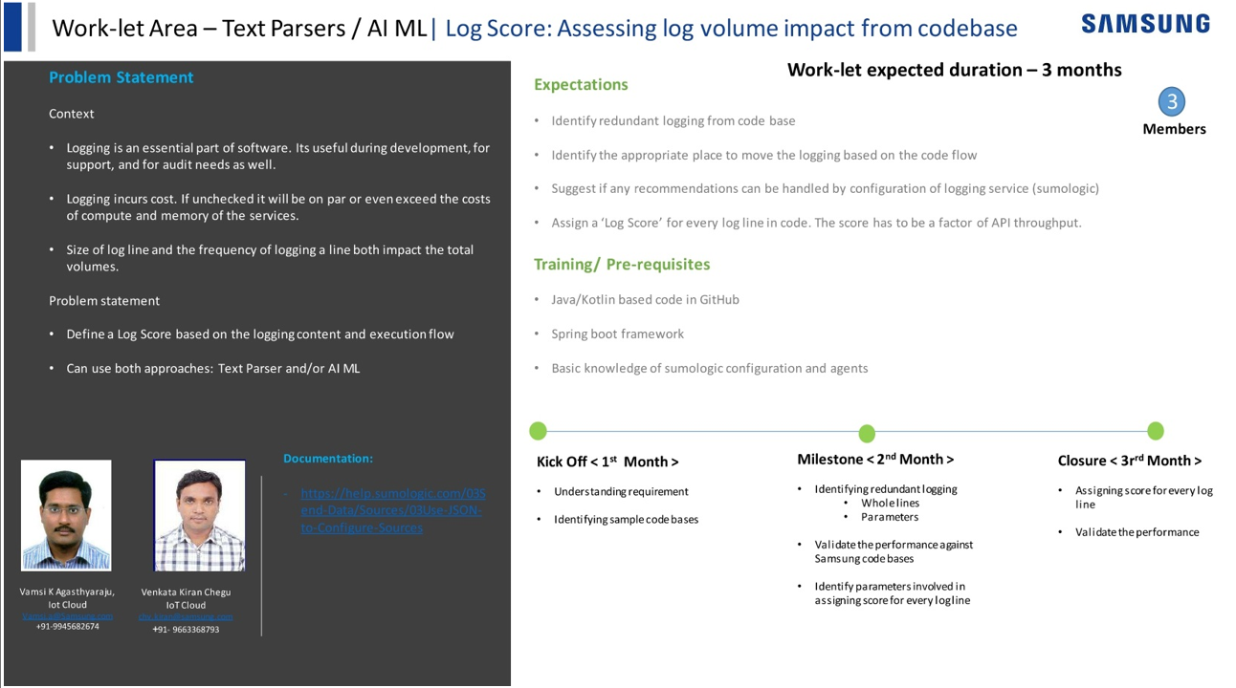
Notes:
-

Slide 3
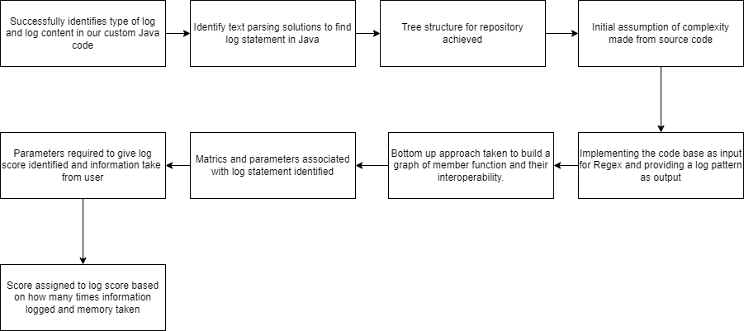
Approach / Solution
Concept Diagram :
( Clear detailed schematic / block diagram / flow chart depicting the proposed concept / solution )

Slide 4
Dataset(s) Analysis / Description
Dataset Capture / Preparation / Generation :
(Discuss the dataset generation process or if downloaded data provide details of what data & from where it was obtained etc… - 2 to 3 bullets only)
Chat-GPT 3.5 Codebase has been used to for the testing the written code
Since the above codebase was huge, a sample custom codebase was also written by us for small tests
Dataset Understanding / Analysis :
(Provide 2 to 3 bullets about what is your understanding of the data / opinion about the data)
The Chat-GPT 3.5 Codebase is written in Java and uses Logging just like any other codebase out there
Dataset Pre-Processing / Related Challenges (if any) :
(List out the challenges you fore see in data handling wrt problem definition – 2 to 3 bullets only)
The GPT Codebase was difficult to understand In the earlier phases, so we used a custom codebase to make modular tests on what we found/wanted to test, there are two files for the same, named samPRISM.ipynb(for the main codebase) and testPRISM.ipynb(for testing functionalities in a modular way)

Slide 5
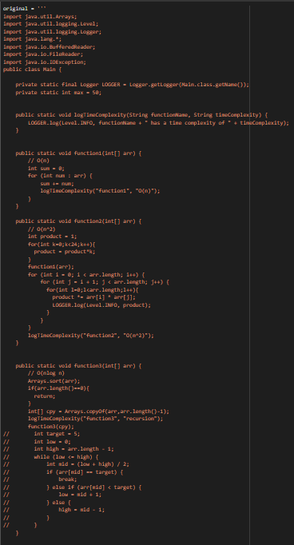
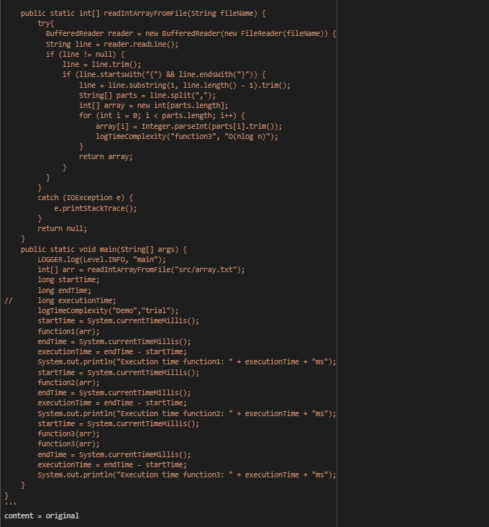
Experimental Results / Simulations / Observations
Results :
(provide numerical data / bar charts / plots / images / videos / tabulated results etc. Use full slide or multiple slides up to max 3 slides to demonstrate the results)
The custom codebase used In testPRISM.ipynb

Slide 6
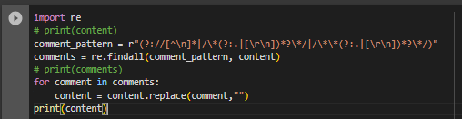
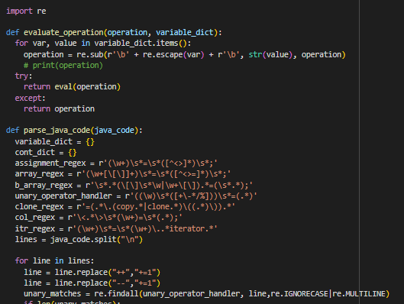
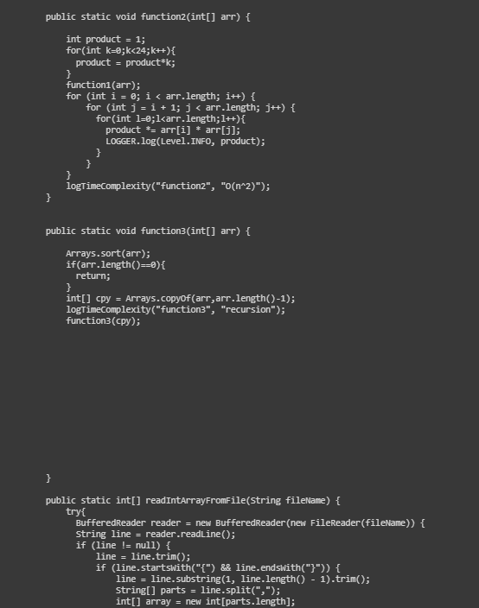
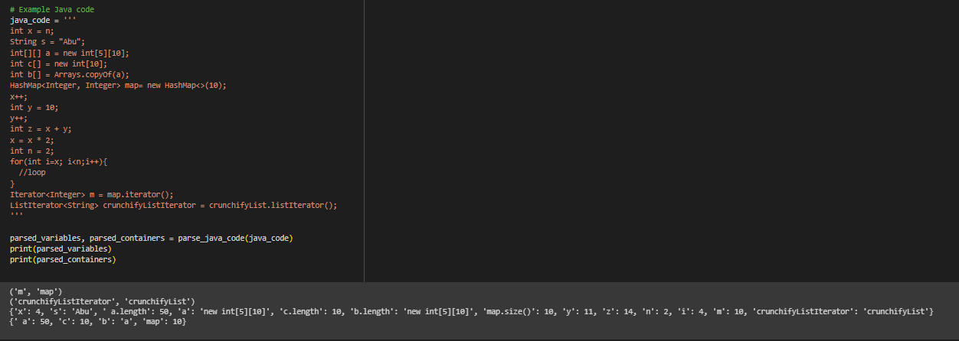
Step 2: Function to auto-evaluate variables
depending on what is known
Step 1: Remove Comments
Output:
Output:

Slide 7
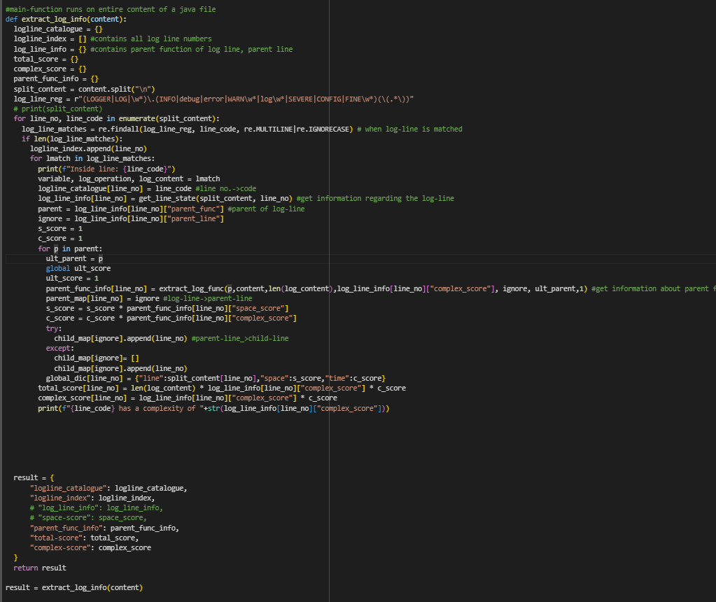
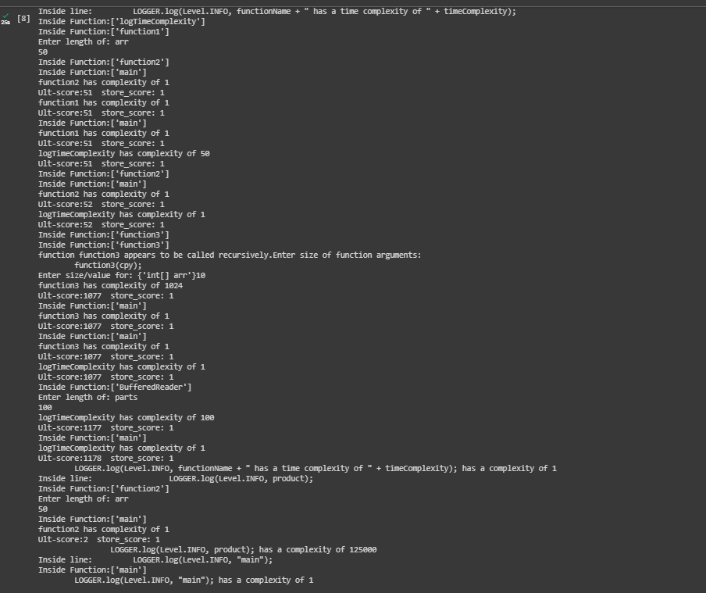
Step 3: Extract Log-lines and find score within parent function and trace parent functions recursively.
Find the number of times log statement will be executed and prompt the user to input what is required.
Output:

Slide 8
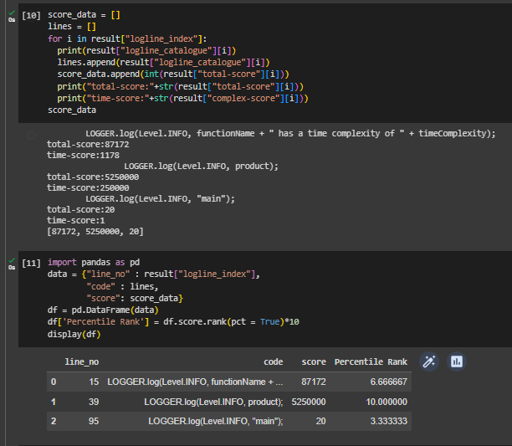
Step 4: Compiling Data and assign score between based on Percentile rank 10 being the most complex logging operation

Slide 9
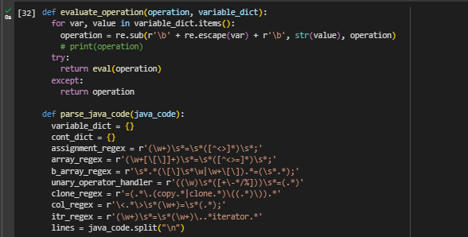

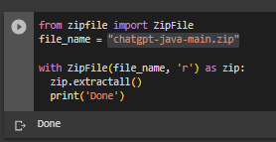
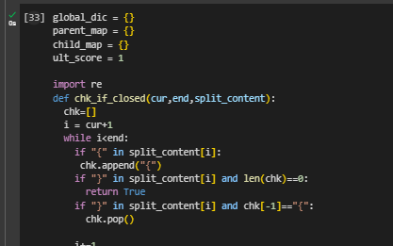
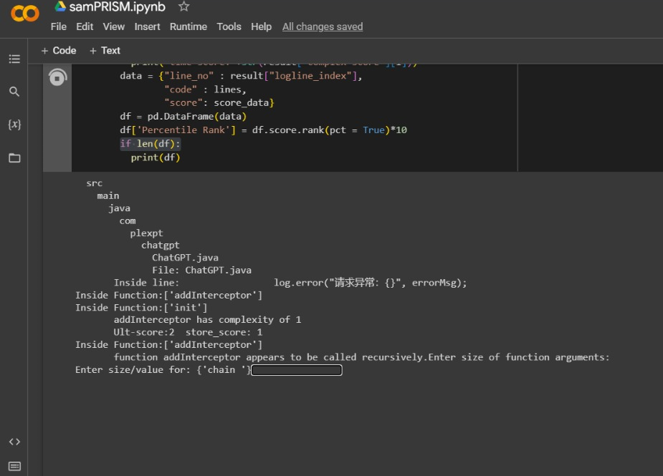
Final Working Log Score Model : samPRISM.ipnyb
Input Codebase as zip
File and unzip contents
By editing file_name
Run both the code cells to initialise the functions and start calculating score
Give required inputs to calculate the cost for the log-line based on data inputs for the codebase

Slide 10
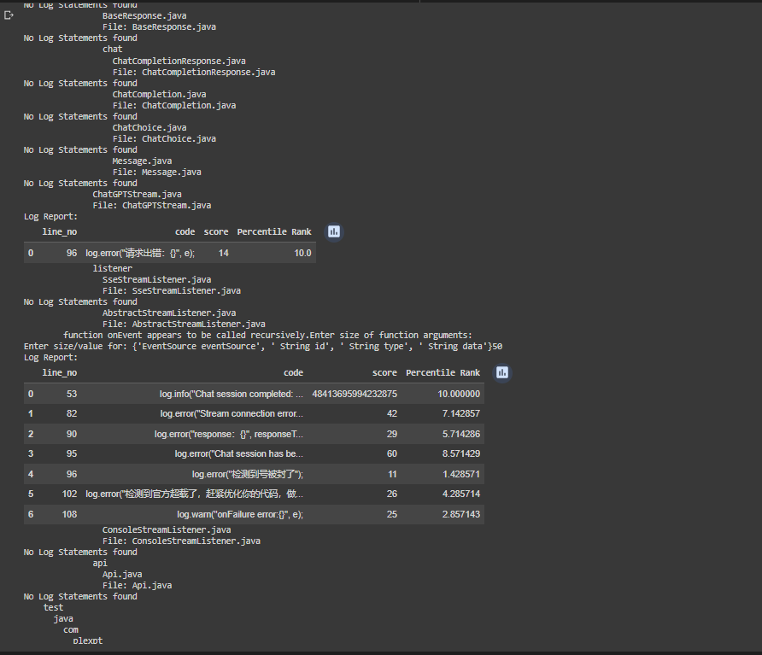
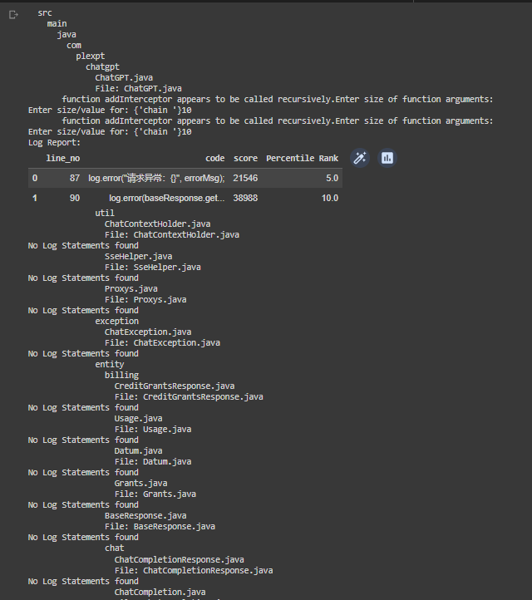
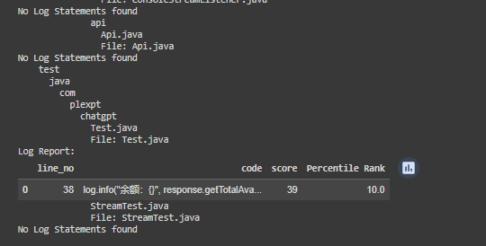
Results: Directory tree traversal
-> Find log lines
-> Assign scores

Slide 11
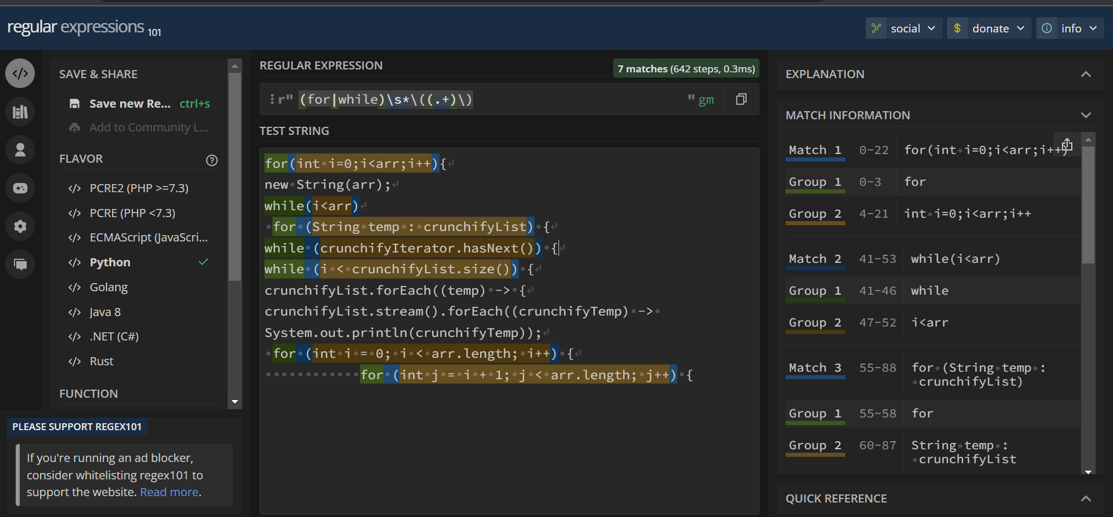
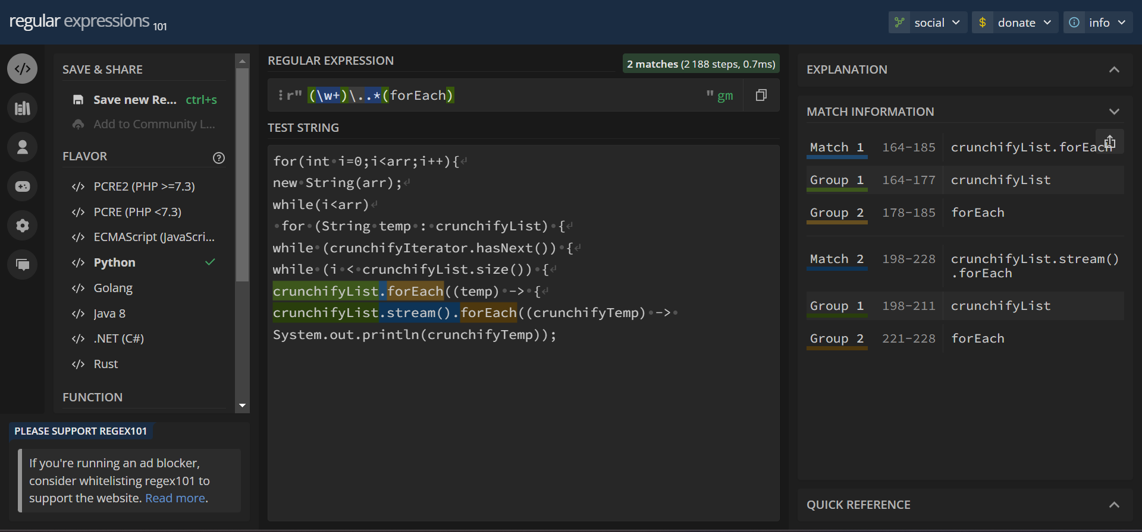
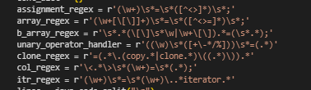
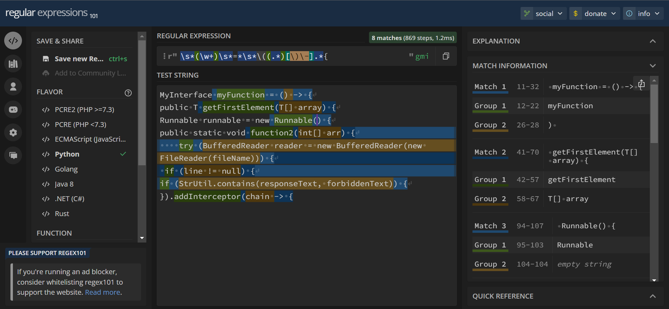
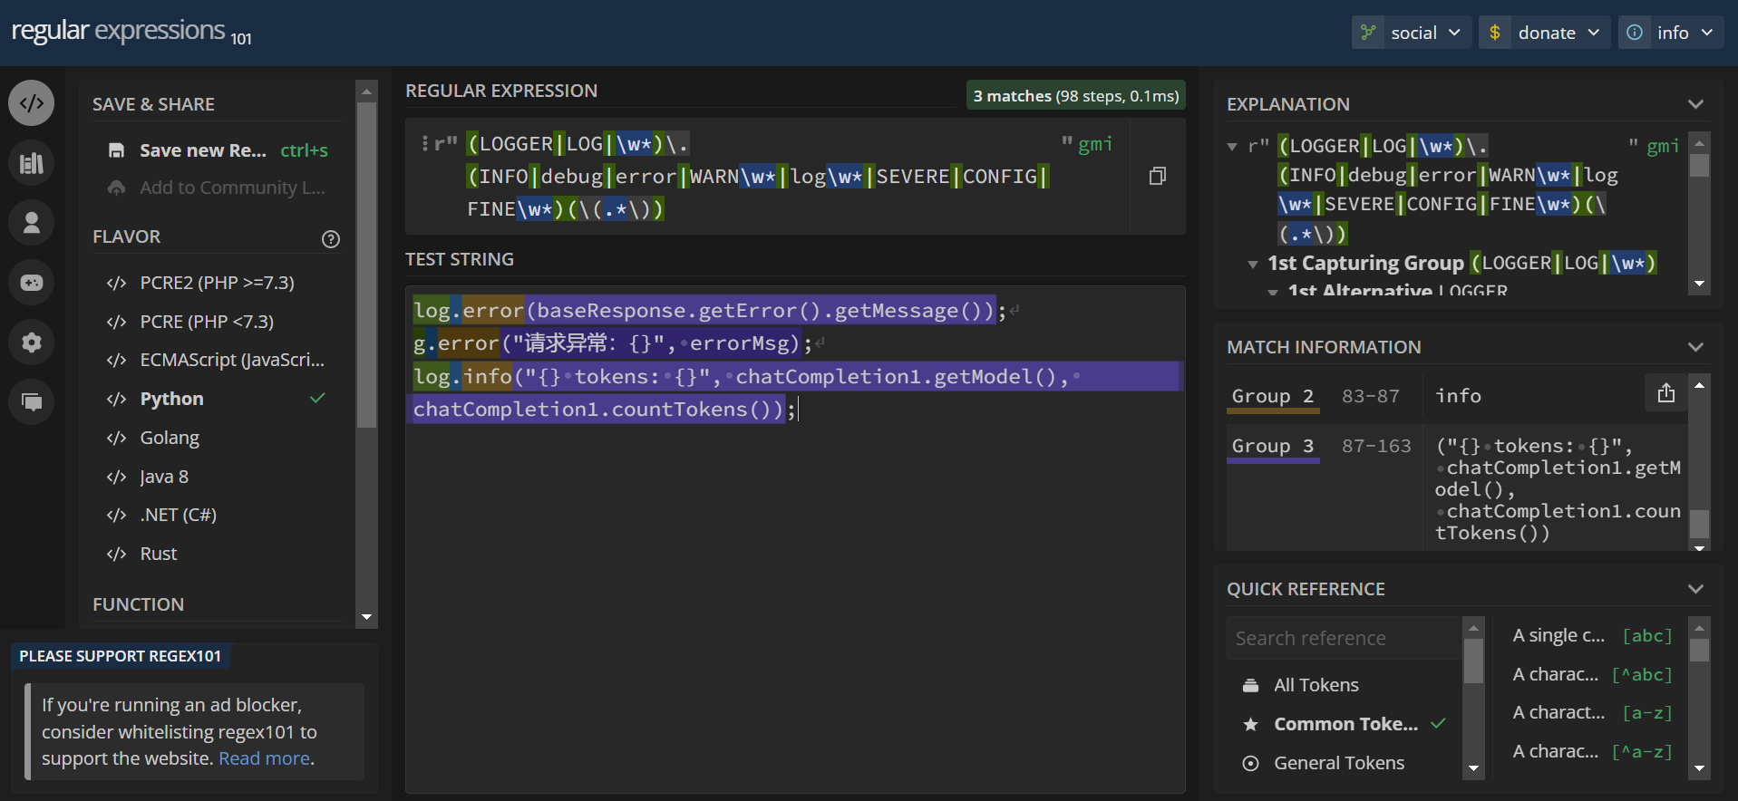
Text Parsers

Slide 12
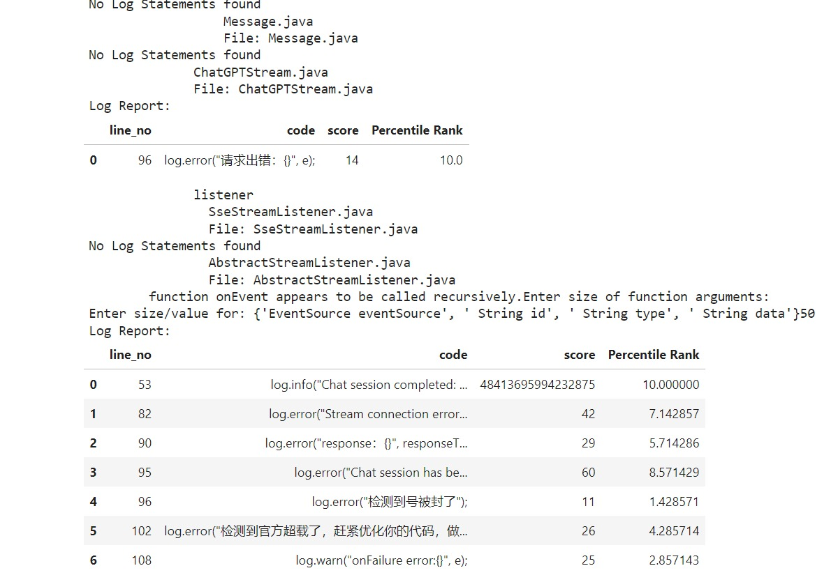
Output generated
SCORE

Slide 13
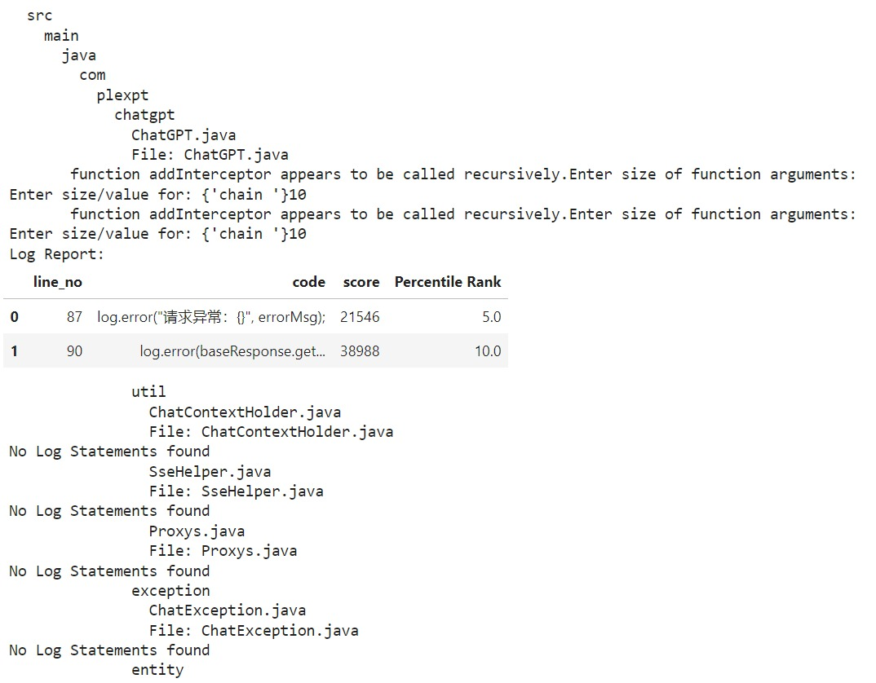
SCORE

Slide 14
Deliverable
Final Deliverables :
(Discuss in the form of bullets, what are the next steps to complete the solution, any road blocks / bottlenecks, any support needed from SRIB)
Testing for more industrial codebases remains.
Conditional checks not implement for exit cases of recursion.
If any aspect of Java Programming has not been considered and for further developments/ queries (uncomment the print statements and print the debug variables) or email here.
IP / Paper Publication Plan :
(Details of papers / patentable ideas / innovative aspects that can lead to patentable ideas)
NA
KPIs delivered/Expectations Met:
(Planned Expectations shared in Work-let vs Delivered Results)
Identify Log Lines.
Identify parameters associated with every Log Line.
Identify score associated for every Log Line.

Slide 15
Work-let Closure Details
Code Upload details:
Items | Details
KLOC (Number OF Lines of codes in 000’s) | 2.5k
Model and Algorithm details | Regex and Text Parsing
Is Mid review, end review report uploaded on Git ? | Done
Link for Git | https://github.ecodesamsung.com/SRIB-PRISM/VIT_Vellore_IOTS62VIT_Text_Parsers_AI_ML_Log_Score_Assessing_log_volume_impact_from_codebase
Data details (if applicable):
Items | Data folder 1 | Data folder 2 | Data Folder 3……..
Name & Type of Data (Audio/Image/Video) | ChatGPT Java API | Self-written Testing Code
Number of data points | - | -
Source of Data (self collected, Scrapped, available on open source) | Open source | Self collected
Google drive link/ git link to access data | https://github.com/PlexPt/chatgpt-java | Test data
Note: If data uploaded on google drive, access to be shared to prism.srib@gmail.com

Slide 16
Thank you

